Slide 1
The Perth Restaurant Industry
A study into the socio-economic factors that drive restaurant consumer decision making
Team: Josh Cullen, Hideaki Kaneko, Matt Vella

Slide 2
Executive Summary
With restaurants in Perth, are there links which can be derived between certain characteristics of eateries relative to typical socio-economic factors such as age, gender, income.
Further, are there inferences which can be made about different suburbs in Perth and their socio-economic data.

Slide 3
Executive Summary
To explore these questions, we aim to explore the following questions:
Is there a link between household income and a willingness to dispense with that income?
If there is a link, does this also translate to food spending habits?
Is there a relationship between the number of restaurants and the median household income?
What about population density and the number of reviews?
Given the previous two questions, what may this infer about the accuracy or interpretation of restaurants.

Slide 4
Data Sources
The data sources used to compile this study include:
WA Census Data – 2016 Census GCP State Suburbs for WA (https://www.abs.gov.au/census/find-census-data)
WA Perth Metro Housing Price Data (https://www.kaggle.com/syuzai/perth-house-prices)
Google Places API – to source restaurant information using suburb information (Overview | Places API | Google Developers)
Using the textsearch format

Slide 5
Data Sources
WA Census Data:
Had to reconcile Census_Code_2016 suburb coding to WA postcodes and suburb names.
Had to consolidate a range of socio-economic indicators through the various catalogues published through the data source.
Limitation that the last census was completed in 2016 and subsequently, some suburbs have experienced some gentrification which may impact the analysis.

Slide 6
Data Sources
WA Perth Metro Housing Price Data:
Data set was scraped from http://house.speakingsame.com/ and includes housing sale data for ~322 Perth suburbs.
Google Places API:
Initial plan was to use the Zomato API, but this is no longer available.
Google Places API limited to 3 pages of results with 20 results per page.
Some suburbs may have in excess of 60 restaurants which may distort some of the average statistics.

Slide 7
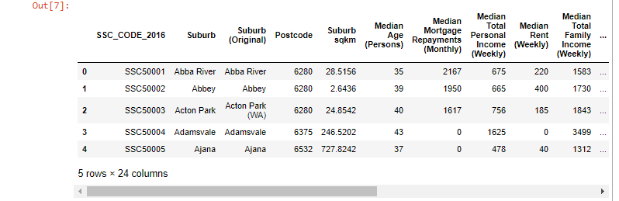
Data Cleanup and Exploration
Fortunately, majority of the data sources provided sufficiently clean data to commence analysis.
Census data was scattered across multiple sheets and tables.
Manual reconciliation of key data was required into a singular CSV file.
Completed primarily with the use of Excel’s XLOOPUP function.

Slide 8
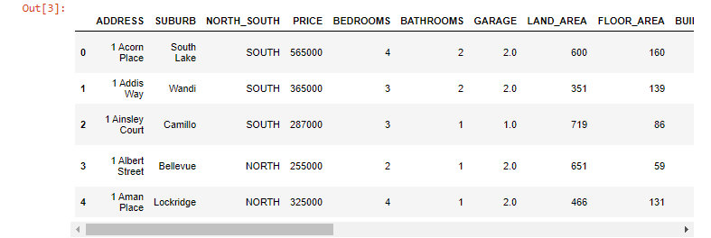
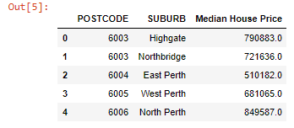
Data Cleanup and Exploration
Housing price data was provided with a range of specific house characteristics which were not required for this analysis.
As such, a clean operation on this data set was completed to only contain the price.
Before Clean.
N.B: NORTH_SOUTH determination of suburb was based on Lat / Lng co-ordinates to the Perth CBD.
After Clean, with median house prices calculated.

Slide 9
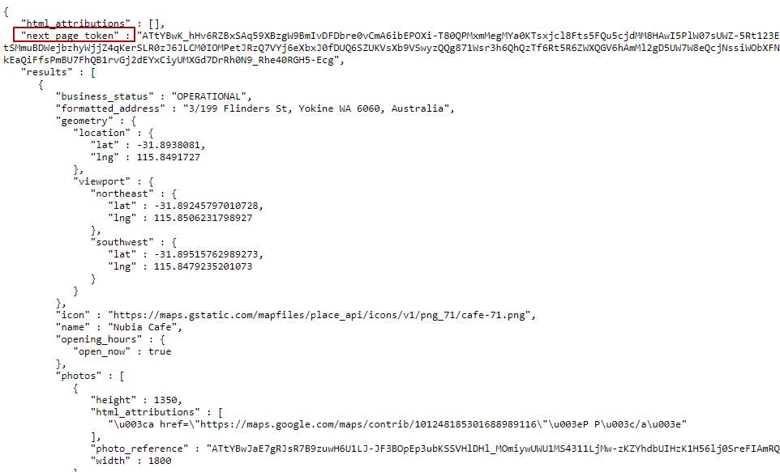
Data Cleanup and Exploration
Key difficulty encountered with Google API.
Google API relies on a pagetoken parameter which has to be fed back into the query to get the results of which new page contained within the initial base call.
pagetoken parameter contained in the first response of the query.
To obtain up to the API maximum of 60 results, the pagetoken parameter has to be taken, and placed at the end of the initial query up to 2 more times.
The limit of 60 results cannot be overcome and may consequently distort the analysis as there may be suburbs with > 60 restaurants in turn affecting their min / max values in the analysis.
Using average measures may limit this distortion.

Slide 10
Data Cleanup and Exploration
Due to the size of the resulting API query, our code and analysis has been split into two sections.
Section 1: Data import, clean and API call.
Section 2: Data analysis.

Slide 11
Data Cleanup and Exploration
Section 1: Data Import, Clean Up and API Calls

Slide 12
Data Cleanup and Exploration
Section 2: Data Analysis

Slide 13
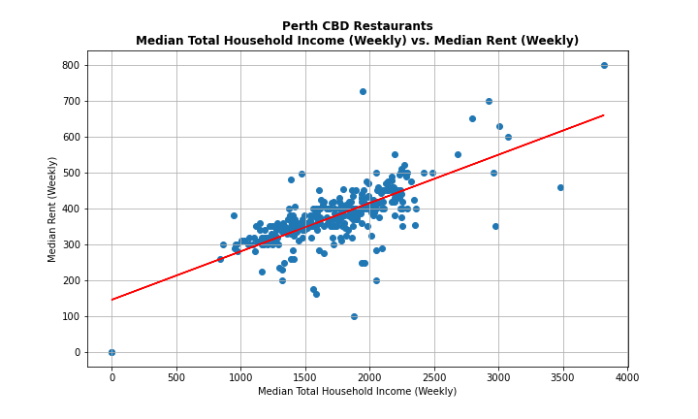
Data Analysis
Firstly, we need to establish if there is a trend between household income and rent.
Correlation Coefficient: 0.73
There appears to be a relatively strong positive linear relationship between the median household income and rent.
Therefore, this would support the idea that those with higher incomes, are more willing to spend on things like rent.
Does this translate to their restaurant preferences?

Slide 14
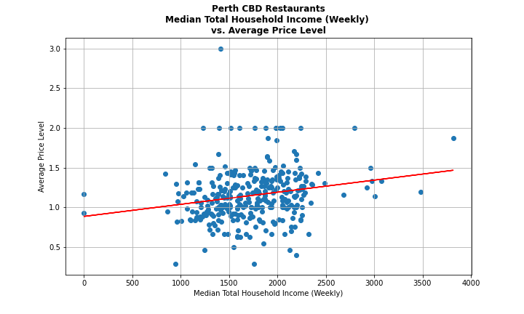
Data Analysis
What about total household income vs. the average price of restaurants in these suburbs?
Correlation Coefficient: 0.21
There appears to be a relatively weak but positive linear relationship between the median household income and price level.
This would suggest that they may be a weak tendency to find relatively more expensive restaurants in suburbs which tend to have a higher household income.
Of note as well, is that the price levels of restaurants at lower incomes tend to be more dispersed.
Is this maybe due to there being more fast food options in lower income suburbs?

Slide 15
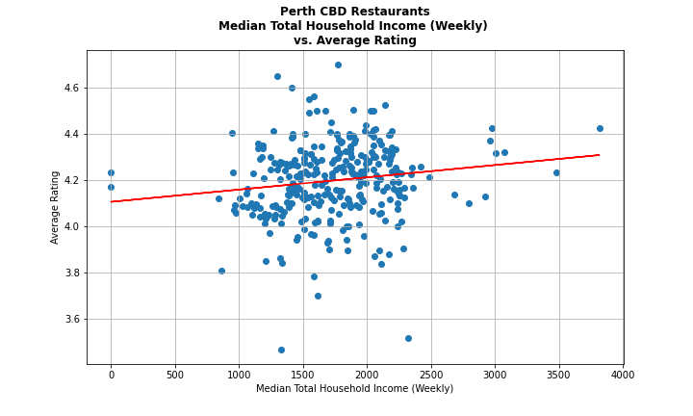
Data Analysis
What about total household income vs. the average rating of these restaurants?
Correlation Coefficient: 0.15
There appears to be a relatively weak but positive linear relationship between the median household income and the average ratings of restaurants in that suburb.
This may imply that suburbs with a higher disposable income tend to seek a higher quality of meal.
Additionally, in the higher income ranges there appears to be a narrow spread of ratings, perhaps supporting the above observation.

Slide 16
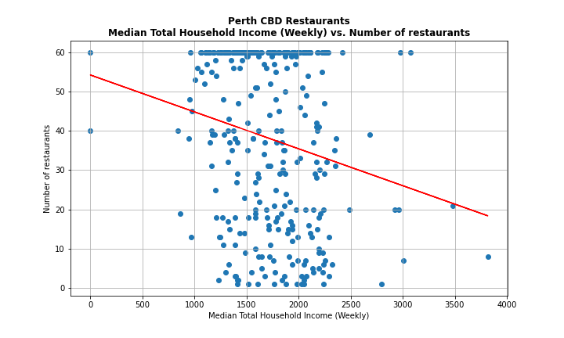
Data Analysis
What about total household income vs. the number of restaurants?
Correlation Coefficient: -0.2
There appears to be a relatively weak but negative relationship between the median household income and the number of restaurants.
This is somewhat surprising as you would expect there to be higher demand for restaurants provided that these suburbs have a higher capacity to spend.
Perhaps it is a greater willingness to travel for food?
Less fast-food options? Especially for suburbs with >$2,500 / week.
Impact of the 60-result limitation to the API call?
Comparison between high income suburbs with city-based professionals, compared to high income, FIFO workers who may not be home and therefore, limits demand on restaurants.

Slide 17
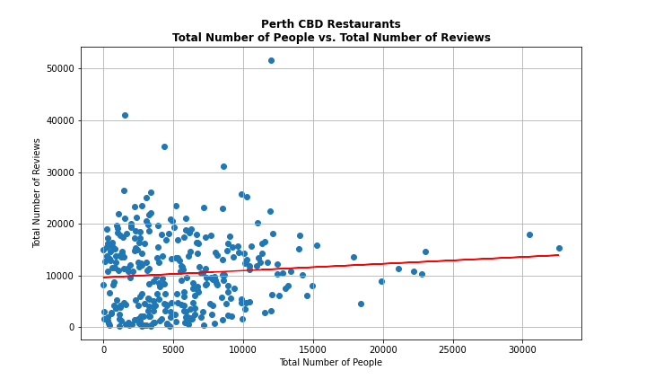
Data Analysis
What about population density vs. the total number of reviews reported on restaurants?
Correlation Coefficient: 0.08
The correlation coefficient would appear to suggest that there is virtually no relationship between the two variables.
However, analysing the data, an inference that could be made is that more densely populated suburbs may be a result of a more family orientated suburb. Potential reasons for this include a) having children may simply reduce the desire to go out for meals and/or b) having children in attendance may reduce the willingness (time) to write a review.
Conversely, less densely populated suburbs may be a result of young single professionals choosing to live closer to the CBD and having more time and willingness to review restaurants.

Slide 18
Discussions & Findings
There appears to be some positive correlation between household income, the average price level and ratings of restaurants found in different suburbs. This could be a result of higher household income suburbs having a higher disposition to spend.
There is a loose negative trend between household income and the number of restaurants. Perhaps this is due to there being less demand for a variety of cheaper alternatives such as fast-food? Supply and Demand?

Slide 19
For Future Consideration
Consider the average household size in some of the analysis.
Fast food restaurants may potentially distort some of the results.
For future analysis, we may consider to re-plot the data excluding fast-food chains to see if this results in stronger or weaker relationships.
Find a way (alternative APIs) which may not have similar limitations to that of Google.

